Slide 1
THE LIFE OF CHRIST
PART 8

Slide 2
Mark 1:1The beginning of the gospel of Jesus Christ, the Son of God.

Slide 3
John 5:18 Therefore the Jews sought all the more to kill Him, because He not only broke the Sabbath, but also said that God was His Father, making Himself equal with God.

Slide 4
Luke 3:1 Now in the fifteenth year of the reign of Tiberius Caesar, Pontius Pilate being governor of Judea, Herod being tetrarch of Galilee, his brother Philip tetrarch of Iturea and the region of Trachonitis, and Lysanias tetrarch of Abilene, ² while Annas and Caiaphas were high priests, the word of God came to John the son of Zacharias in the wilderness.

Slide 5
Pontius Pilate, Roman Governor of Judaea (26 A.D. to 36 A.D.).
Herod (Antipas), tetrarch of Galilee (4 B.C. to 39 A.D.). This is the Herod that would John’s head put on a platter.
Philip, tetrarch of Iturea (iht you REE ah) (4 B.C. to 34 A.D.).
Lysanias, tetrarch of Abilene (not certainly known).

Slide 6
Annas and Caiaphas, high priests in Jerusalem: Annas was high priest from 7 B.C., and although deposed in 15 A.D., continued to be recognized by the Jews as the true high priest. Caiaphas was only one of five sons and sons-in-law of Annas, among whom the high priesthood was rotated during New Testament times. Caiaphas was named high priest, perhaps briefly, in 18 A.D.; and Dummelow stated that he was appointed "before 26 A.D., being deposed in 37 A.D." Significantly, Luke regarded Annas and Caiaphas as joint-high priests, corresponding exactly with statements in John.

Slide 7
Pontius Pilate, Roman Governor of Judaea
(26 A.D. to 36 A.D.).
3.5 years – 36 = 32 A.D.
Earliest their ministries could begin 26 A.D. and the latest 32 A.D.

Slide 8
Tiberius Caesar
Began his reign on Sep. 17 A.D. 14.
Luke 3:23 tells us that Jesus was about 30 years old when He began His ministry.
The 6th century monk added 15 years to 14. A.D., which would put the beginning of John’s and Jesus’s ministry around A.D. 29. Since Jesus was about 30, he counted backwards 30 years starting at A.D. 30 and made that the beginning of the A.D. calendar.
If you add three and half years to A.D. 30, then you have the church being established in A.D. 33.

Slide 9
Tiberius began his joint reign with Augustus Caesar in A.D. 11. As the Encyclopedia Britannica points out:
From the beginning of 11, when he celebrated a magnificent triumph, to the time of the emperor's death in 14, Tiberius remained almost entirely in Italy, and held rather the position of joint-emperor than that of expectant heir.

Slide 10
I have already shown in previous lessons that Jesus had to be born before 4. B.C., which would make impossible for John and Jesus to begin their ministry in A.D. 29.

Slide 11
When we use Jesus’ approximate birth year along with Luke counting Tiberius’ reign starting from A.D. 11, we arrive at the approximate date of A.D. 26, which means that the church was established in A.D. 30 instead of A.D. 33.

Slide 12
Also, in John 2:20, Jesus was at the beginning of His ministry, when the Jews make the statement that the temple has been under construction for 46 years. According to Josephus and other historians, Herod began the construction around 20-19 B.C. If you add 46 years to that, you end up at A.D. 26-27.

Slide 13
Luke 3:3 And he went into all the region around the Jordan, preaching a baptism of repentance for the remission of sins, ⁴ as it is written in the book of the words of Isaiah the prophet, saying: "The voice of one crying in the wilderness: 'Prepare the way of the LORD; Make His paths straight. ⁵ Every valley shall be filled And every mountain and hill brought low; The crooked places shall be made straight And the rough ways smooth; ⁶ And all flesh shall see the salvation of God.' "

Slide 14
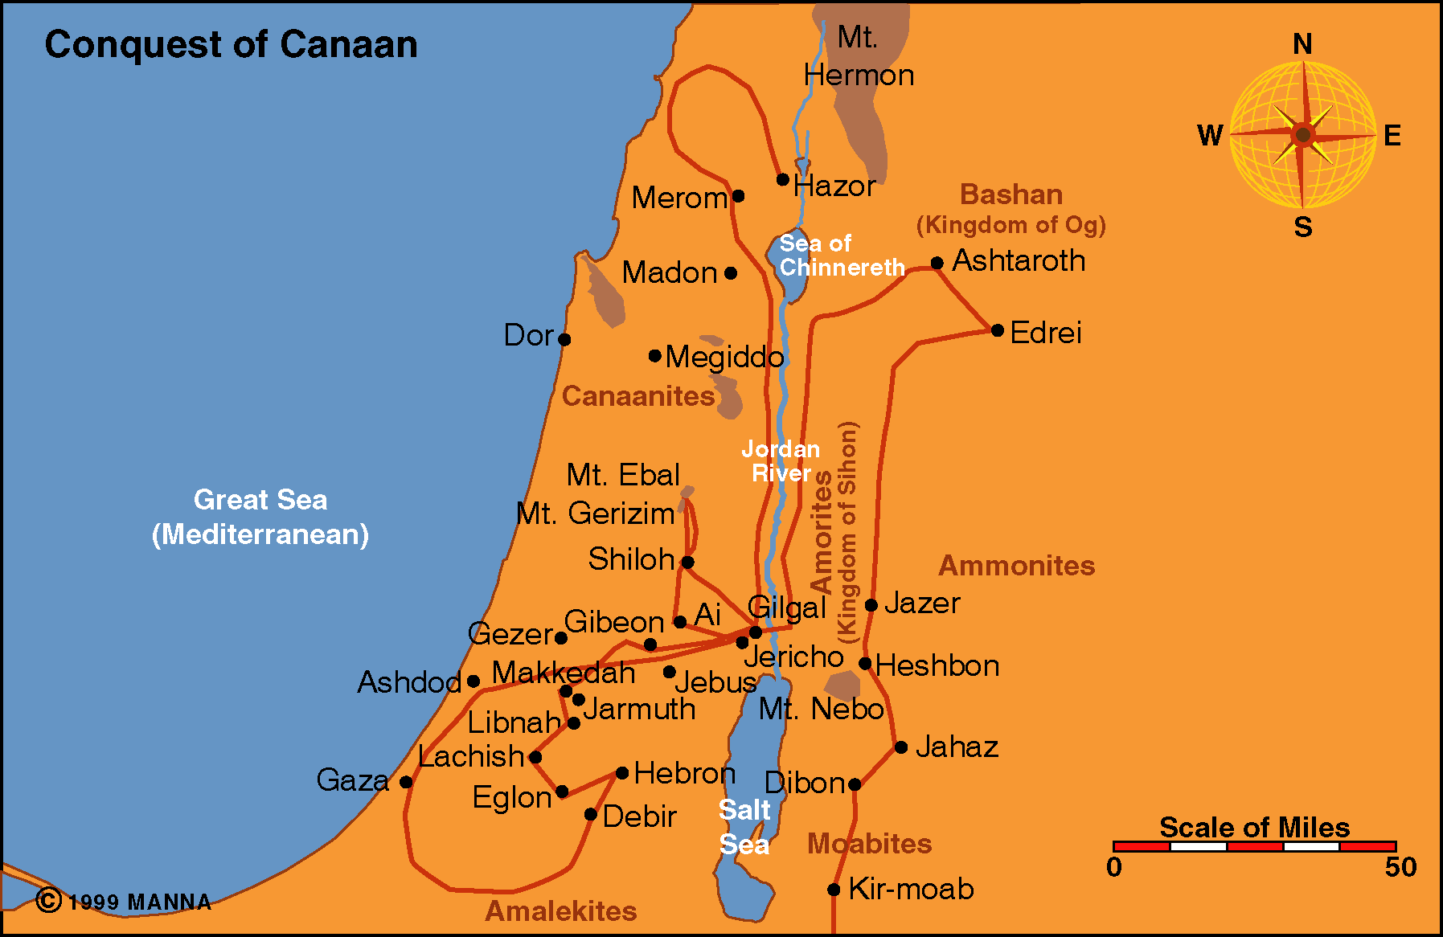

Slide 15
, ⁴ as it is written in the book of the words of Isaiah the prophet, saying: "The voice of one crying in the wilderness: 'Prepare the way of the LORD; Make His paths straight. ⁵ Every valley shall be filled And every mountain and hill brought low; The crooked places shall be made straight And the rough ways smooth; ⁶ And all flesh shall see the salvation of God.' “
Verses 4 – 6 contains two quotes from Isa.40:3-4 and 52:10.

Slide 16
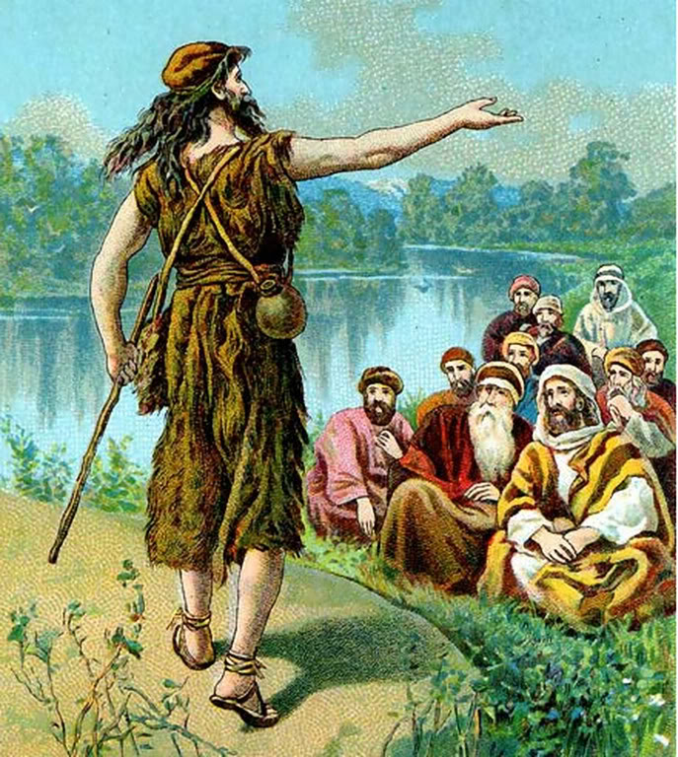
Matthew 3:4 And John himself was clothed in camel's hair, with a leather belt around his waist; and his food was locusts and wild honey. ⁵ Then Jerusalem, all Judea, and all the region around the Jordan went out to him ⁶ and were baptized by him in the Jordan, confessing their sins.

Slide 17
Luke 3:7 Then he said to the multitudes that came out to be baptized by him, "Brood of vipers! Who warned you to flee from the wrath to come? ⁸ "Therefore bear fruits worthy of repentance, and do not begin to say to yourselves, 'We have Abraham as our father.' For I say to you that God is able to raise up children to Abraham from these stones. ⁹ "And even now the ax is laid to the root of the trees. Therefore every tree which does not bear good fruit is cut down and thrown into the fire."

Slide 18
Luke 7:30 But the Pharisees and lawyers rejected the will of God for themselves, not having been baptized by him.

Slide 19
2 Corinthians 5:10 For we must all appear before the judgment seat of Christ, that each one may receive the things done in the body, according to what he has done, whether good or bad.

Slide 20
Hebrews 4:12 For the word of God is living and powerful, and sharper than any two-edged sword, piercing even to the division of soul and spirit, and of joints and marrow, and is a discerner of the thoughts and intents of the heart. ¹³ And there is no creature hidden from His sight, but all things are naked and open to the eyes of Him to whom we must give account.

Slide 21
Luke 3:10 So the people asked him, saying, "What shall we do then?" ¹¹ He answered and said to them, "He who has two tunics, let him give to him who has none; and he who has food, let him do likewise." ¹² Then tax collectors also came to be baptized, and said to him, "Teacher, what shall we do?" ¹³ And he said to them, "Collect no more than what is appointed for you." ¹⁴ Likewise the soldiers asked him, saying, "And what shall we do?" So he said to them, "Do not intimidate anyone or accuse falsely, and be content with your wages."

Slide 22
Luke 3:15 Now as the people were in expectation, and all reasoned in their hearts about John, whether he was the Christ or not, ¹⁶ John answered, saying to all, "I indeed baptize you with water; but One mightier than I is coming, whose sandal strap I am not worthy to loose. He will baptize you with the Holy Spirit and fire. ¹⁷ "His winnowing fan is in His hand, and He will thoroughly clean out His threshing floor, and gather the wheat into His barn; but the chaff He will burn with unquenchable fire."

Slide 23
John talks about three different baptisms.
Water baptism
Holy Spirit baptism Lk. 24:49; Acts 1:8; Acts 1:26 – 2:4; Acts 2:38-39; Acts 2:38-39
Baptism of fire Mt.25:41-46

Slide 24
¹⁷ "His winnowing fan is in His hand, and He will thoroughly clean out His threshing floor, and gather the wheat into His barn; but the chaff He will burn with unquenchable fire."

Slide 25
Luke 3:18 And with many other exhortations he preached to the people. ¹⁹ But Herod the tetrarch, being rebuked by him concerning Herodias, his brother Philip's wife, and for all the evils which Herod had done, ²⁰ also added this, above all, that he shut John up in prison.

Slide 26
Acts 5:41 So they departed from the presence of the council, rejoicing that they were counted worthy to suffer shame for His name.
Matthew 10:28 "And do not fear those who kill the body but cannot kill the soul. But rather fear Him who is able to destroy both soul and body in hell.

Slide 27
Matthew 3:13 Then Jesus came from Galilee to John at the Jordan to be baptized by him. ¹⁴ And John tried to prevent Him, saying, "I need to be baptized by You, and are You coming to me?" ¹⁵ But Jesus answered and said to him, "Permit it to be so now, for thus it is fitting for us to fulfill all righteousness." Then he allowed Him.

Slide 28
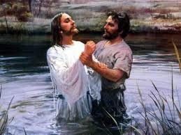

Slide 29
Luke 3:21 When all the people were baptized, it came to pass that Jesus also was baptized; and while He prayed, the heaven was opened. ²² And the Holy Spirit descended in bodily form like a dove upon Him, and a voice came from heaven which said, "You are My beloved Son; in You I am well pleased."

Slide 30
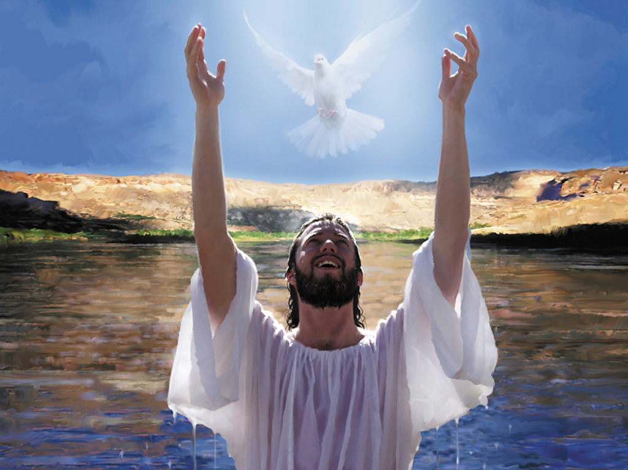

Slide 31
Matthew 7:21 " Not everyone who says to Me, 'Lord, Lord,' shall enter the kingdom of heaven, but he who does the will of My Father in heaven.
Revelation 2:10 Be faithful until death, and I will give you the crown of life.

Slide 32
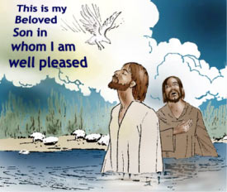

Slide 33
Luke 3:23 Now Jesus Himself began His ministry at about thirty years of age, being (as was supposed) the son of Joseph, the son of Heli,

